Slide 1
SCADA Architecture

Slide 2
SCADA SYSTEM ARCHITECTURE -
Components
Operator: Human operator who monitors the SCADA system and performs supervisory control functions for the remote plant operations.
Human machine interface (HMI): Presents data to the operator and provides for control inputs in a variety of formats, including graphics, schematics, windows, pull-down menus, touch-screens, and so on.

Slide 3
SCADA SYSTEM ARCHITECTURE -
Components
Master terminal unit (MTU): Equivalent to a master unit in a master/slave architecture. The MTU presents data to the operator through the HMI, gathers data from the distant site, and transmits control signals to the remote site. The transmission rate of data between the MTU and the remote site is relatively low and the control method is usually open loop because of possible time delays or data flow interruptions.
Communications means: Communication method between the MTU and remote controllers. Communication can be through the Internet, wireless or wired networks, or the switched public telephone network.

Slide 4
SCADA SYSTEM ARCHITECTURE -
Components
5. Remote terminal unit (RTU): Functions as a slave in the master/slave architecture. Sends control signals to the device under control, acquires data from these devices, and transmits the data to the MTU. An RTU may be a PLC. The data rate between the RTU and controlled device is relatively high and the control method is usually closed loop.

Slide 5
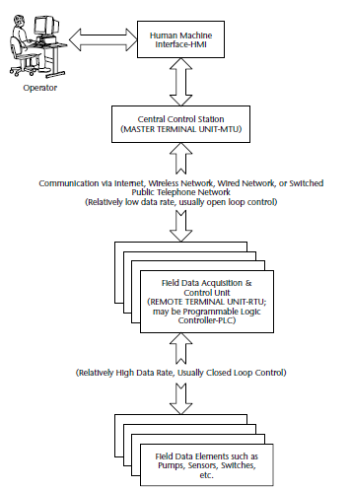
Typical SCADA Systems Architecture

Slide 6
Typical SCADA SYSTEM ARCHITECTURE
SCADA architecture comprises two levels: a master or client level at the supervisory control center and a slave or data server level that interacts with the processes under control.
SCADA software components: SCADA master/client
Human machine interface
Alarm handling
Event and log monitoring
Special applications
ActiveX or Java controls

Slide 7
Typical SCADA SYSTEM ARCHITECTURE
SCADA software components: SCADA slave/data server
Human machine interface
Real-time system manager
Data processing applications
Report generator
Alarm handling
Drivers and interfaces to control components
Spreadsheet
Data logging
Archiving
Charting and trending

Slide 8
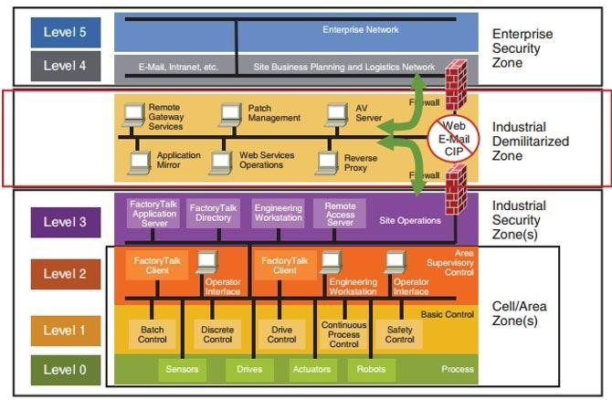
SCADA SYSTEM ARCHITECTURE

Slide 9
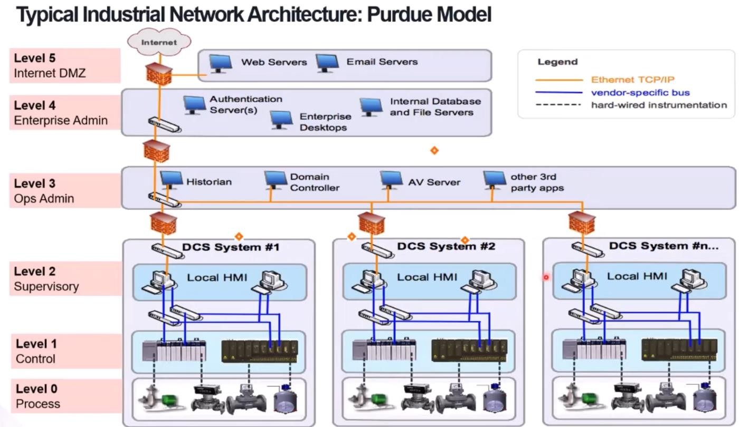
SCADA SYSTEM ARCHITECTURE

Slide 10
SCADA SYSTEM ARCHITECTURE –
PURDUE MODEL
The Purdue Enterprise Reference Architecture (PERA) reference model for enterprise architecture was developed in the 1990’s by Theodore J. Williams and members of the Industry-Purdue University Consortium for Computer Integrated Manufacturing.
This model was adopted by ISA-99 (now ISA/IEC 62443), among other industrial security standards, and used as a key concept for ICS network segmentation.
The Purdue Reference Model, or just “Purdue Model” as it is now called in ICS communities, is widely used to describe the major
interdependencies and interworking between all the major
components in a major ICS and is a good place to start when trying to understand any OT environment.

Slide 11
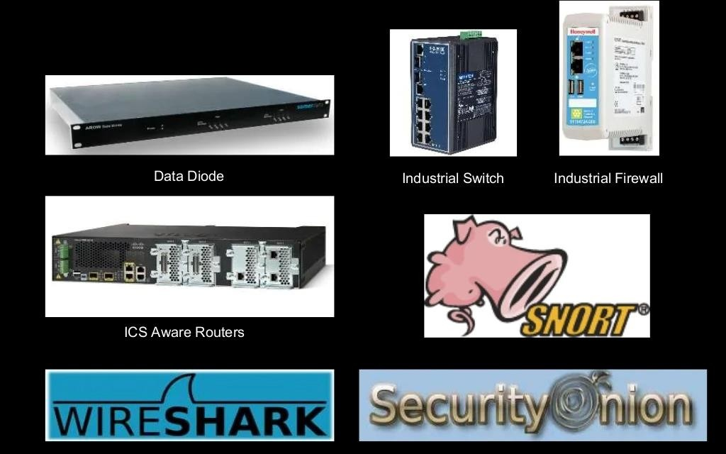
SCADA SYSTEM ARCHITECTURE –
PURDUE MODEL – Enforcement Zone

Slide 12
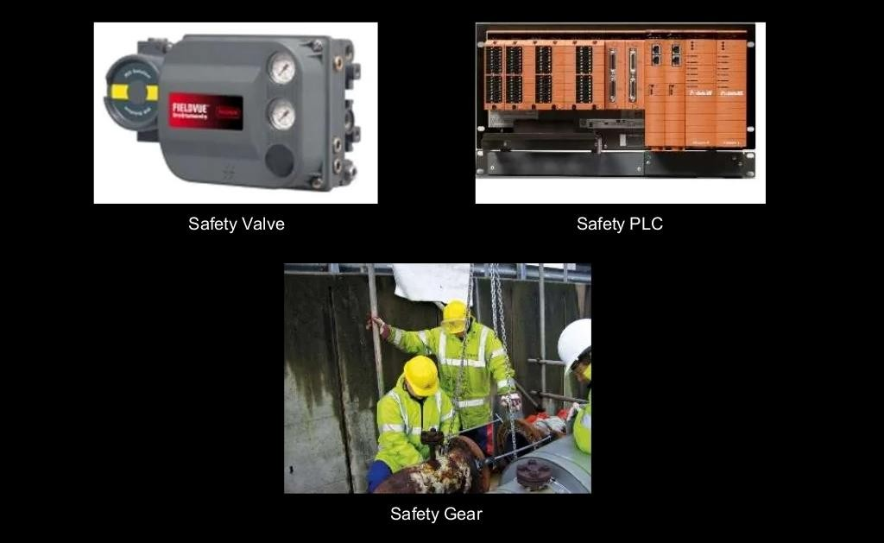
SCADA SYSTEM ARCHITECTURE –
PURDUE MODEL – Safety Zone

Slide 13
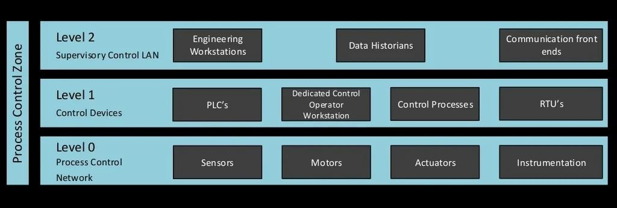
SCADA SYSTEM ARCHITECTURE –
PURDUE MODEL – Process Control Zone

Slide 14
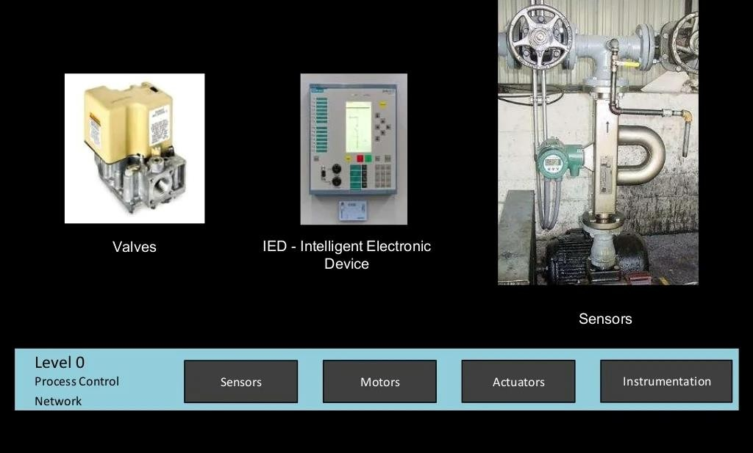
SCADA SYSTEM ARCHITECTURE –
PURDUE MODEL – Process Control Zone

Slide 15
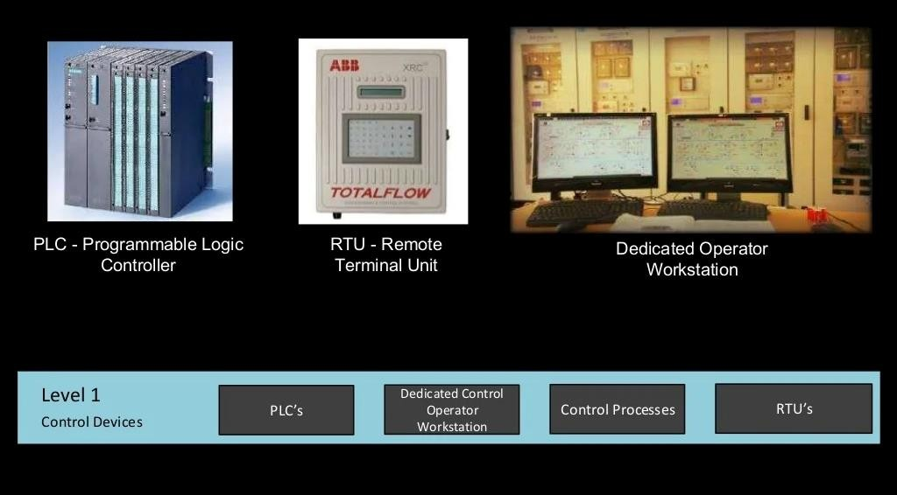
SCADA SYSTEM ARCHITECTURE –
PURDUE MODEL – Process Control Zone

Slide 16
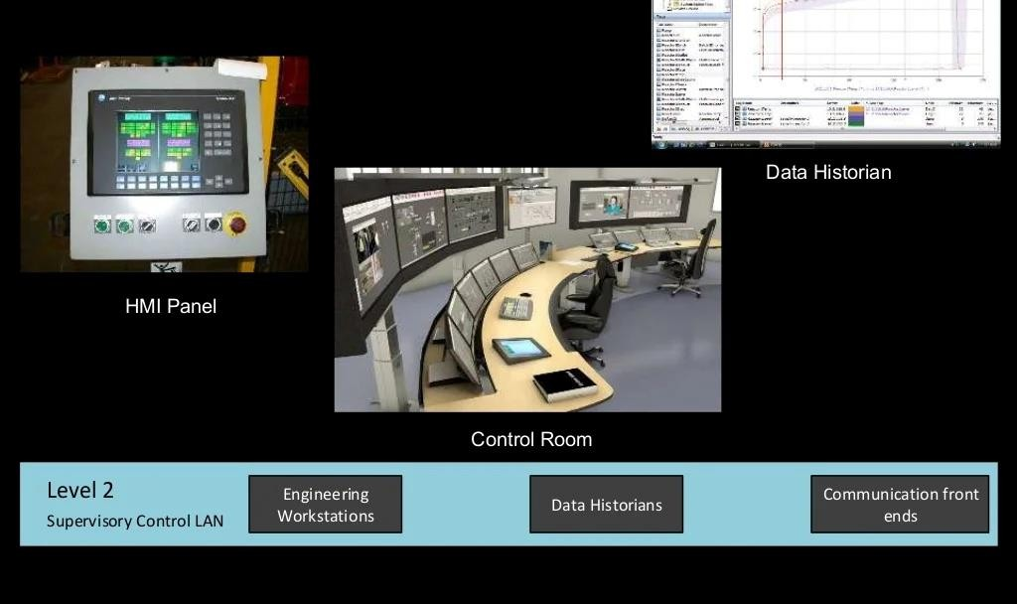
SCADA SYSTEM ARCHITECTURE –
PURDUE MODEL – Process Control Zone

Slide 17
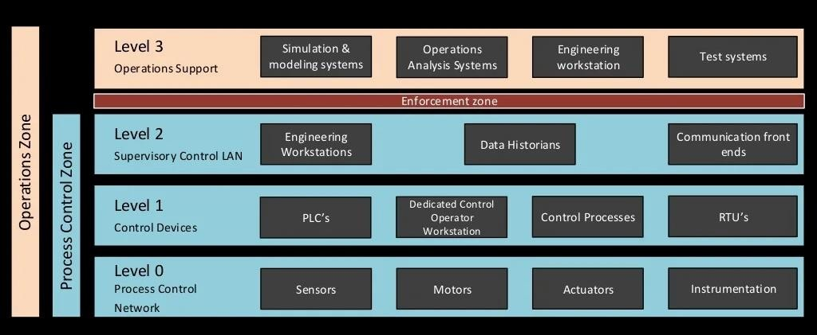
SCADA SYSTEM ARCHITECTURE –
PURDUE MODEL – Operations Zone

Slide 18
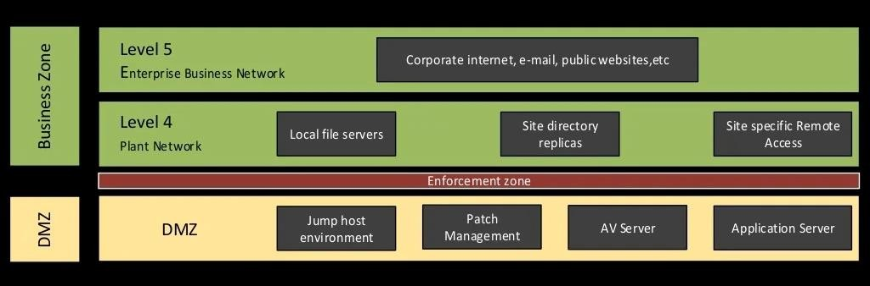
SCADA SYSTEM ARCHITECTURE –
PURDUE MODEL – DMZ & Business Zone

Slide 19
SCADA SYSTEM ARCHITECTURE –
PURDUE MODEL – Level 5 Enterprise Zone
The Enterprise Zone is where the supply chain is managed. ERP systems such as SAP and JD Edwards are used to understand and respond to supply and demand.
These systems take data from all the subordinate systems, often across multiple sites or an enterprise, to look at overall supply, production, and demand to manage work orders.
ICSs are rarely connected directly to this level, but there is a clear demand for accurate and timely information from the various OT networks and ICS components.

Slide 20
SCADA SYSTEM ARCHITECTURE –
PURDUE MODEL – Level 4 Site Business Planning and Logistics
Level 5 usually exists at a corporate or multisite headquarters, Level 4 represents the IT systems used at each site, plant, or facility to control the operation of the local facility.
This level
takes orders from Level 5 and monitors the at lower
performance operations,
levels to understand the state of
performance against
the production the local plant, and
schedule, updating
management of problems at
enterprise systems at Level 5.

Slide 21
SCADA SYSTEM ARCHITECTURE –
PURDUE MODEL – Level 3.5 ICS-Demilitarized Zone
The ICS-Demilitarized Zone (ICS-DMZ) is the layer for sharing information between IT and OT.
This is a more modern construct, driven by standards efforts such as NIST Cybersecurity Framework, NIST 800-82, NERC CIP, and ISA-62443.
Commonly present in the ICS-DMZ are replication servers, patch Management servers, engineering workstations, and configuration/change management systems
The purpose of the DMZ is to provide a secure exchange of IT information without exposing critical components in lower layers directly to attack.

Slide 22
SCADA SYSTEM ARCHITECTURE –
PURDUE MODEL – Level 3 Site Manufacturing and Operations Control
While Levels 5 and 4 exist solely on the IT side of the network, with the DMZ being the filling in the Oreo cookie, so to speak, Levels 3 and below define and comprise the systems on the OT side of the network.
Level 3 typically contains SCADA’s supervisory aspect, DCS view and control access, or the control rooms with view and monitoring functions for the rest of the OT network.
This is the primary layer for operator-level interaction with the system, with operators viewing and monitoring process events and trends, responding to alarms and events, managing uptime and availability of the process with functions such as work order maintenance, and ensuring product quality.

Slide 23
SCADA SYSTEM ARCHITECTURE –
PURDUE MODEL – Level 2 Area Supervisory Control
Level 2 has many of the same functions as Level 3, but this level is where process cell or line-level functions primarily exist for local control over individual areas of a process.
This level is distinguished by being the level where actual ICSs start to appear, such as PLCs and Variable Frequency Drives (VFDs).
However, the main systems at this level include HMIs. Within this level, you see a local view of live process events and
operator-level process interaction through HMI panels and automated control of the process through these logic-driven
components.

Slide 24
SCADA SYSTEM ARCHITECTURE –
PURDUE MODEL – Level 1 Basic Control
Although some PLCs, VFDs, and the like exist at Level 2, this is the primary location for such equipment.
This level compromises what is known as the Basic Process Control Systems, or BPCSs.
BPCS is a generic term applying to nonsafety-related control systems in which the following functions are performed and managed:
BPCSs control the process within configurable limits (known as set points).

Slide 25
SCADA SYSTEM ARCHITECTURE –
PURDUE MODEL – Level 1 Basic Control
BPCS is a generic term applying to nonsafety-related control systems in which the following functions are performed and managed:
BPCSs provide live data to HMIs for operator-level interaction with the process.
Operators interact with the set points and logic of the BPCS at this level to
optimize the plant operations.
Process-level alarms and events are managed and responded to at this level. Level 2 depends on information from Levels 3 and above for schedule, monitoring alarms, and providing feedback on how to manage the process.
BPCSs
measure
also include sensors,
and report process
actuators, relays,
values to PLCs,
and other components
DCSs, SCADA, and
that
other
components in Levels 1-5.

Slide 26
SCADA SYSTEM ARCHITECTURE –
PURDUE MODEL – Level 0 Process
Also known as the Equipment Under Control (EUC) level, this is where the physical equipment that is being controlled by Level 1 is located.
These include drives, motors, valves, and other components that comprise the actual process.
The integrity of Level 0 is paramount to safe and efficient operations, as this is where the actual physics of the process are manipulated. If the BPCS and the EUC fail to operate properly, or the information about the process state is inaccurate, then the BPCS or operators are unable to accurately respond to process conditions.

Slide 27
SCADA SYSTEM ARCHITECTURE –
PURDUE MODEL – Level 0 Process
Also known as the Equipment Under Control (EUC) level, this is where the physical equipment that is being controlled by Level 1 is located.
These include drives, motors, valves, and other components that comprise the actual process.
The integrity of Level 0 is paramount to safe and efficient operations, as this is where the actual physics of the process are manipulated. If the BPCS and the EUC fail to operate properly, or the information about the process state is inaccurate, then the BPCS or operators are unable to accurately respond to process conditions.

